Slide 1
HEALTH CARE Data Analysis Insights –SQL +Python + jupyter notebook
By Yashwanth S
DA&DS-JULY

Slide 2
Project Workflow
1️⃣ Data Import – Load data using Pandas and SQL.
2️⃣ Data Cleaning – Handle null values, remove duplicates.
3️⃣ Data Analysis – Use Pandas + SQL queries to answer key questions.
4️⃣ Visualization – Create meaningful charts.
5️⃣ Insights – Derive business conclusions.
Tools and Technologies Used
🐍 Python – Data analysis & manipulation
🧮 Pandas – Data handling and aggregation
🗄️ SQL Sever Studio – Database & Query-based analysis
📈 Matplotlib / Seaborn – Data visualization
🧑‍💻 Jupyter Notebook – Implementation environment

Slide 3
STEP 1 : DATABASE CONNECTION
Dataset was uploaded in the SQL sever and connect to the jupyter notebook
Pyodbc – python opensource databse connection
Syntex:
import pyodbc
connection=pyodbc.connect(
'DRIVER={ODBC Driver 17 for SQL Server};' 'SERVER=localhost;' 'DATABASE=disease;' 'Trusted_Connection=yes;’)
query=" SELECT * FROM healthcare_dataset“
df=pd.read_sql(query,connection)

Slide 4
STEP 2 : DATA CLEANING
Dataset has one mistaken data type
By using pandas we change the correct datatype :
Syntex:
df.dtypes
df['Visit_Date']=pd.to_datetime(df['Visit_Date'])

Slide 5
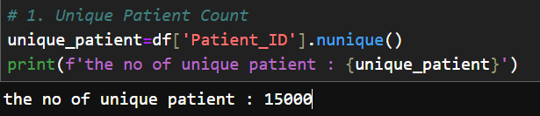
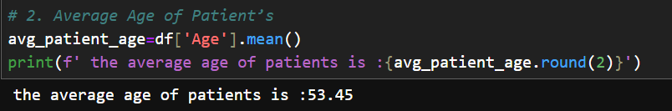
STEP 4 : DATA ANALYSIS
Unique Patient Count
Shows total distinct patients in the dataset.
→ Helps understand sample size and avoid duplicate entries.
Average Age of Patients
Calculates mean age from all records.
→ Reveals general age trend of patients treated.

Slide 6
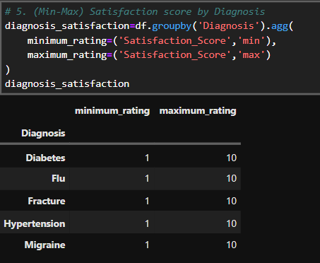
Satisfaction Score Range by Diagnosis
Finds minimum and maximum satisfaction per disease.
→ Evaluates variability of patient experience across conditions.

Slide 7
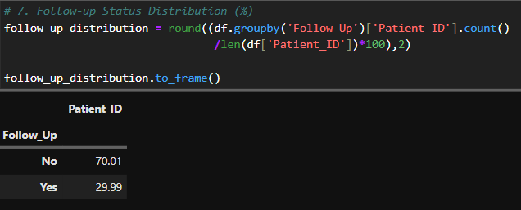
Follow Up percentage
Finds how the patients are follow up their treatment.
→ Show the almost 70% of people were not following up their treatments.

Slide 8
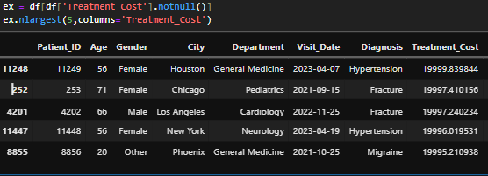
Top 5 Most Expensive Treatments
Finds how the top 5 treatments cost.
→ Shows these patients are has highest treatment cost

Slide 9
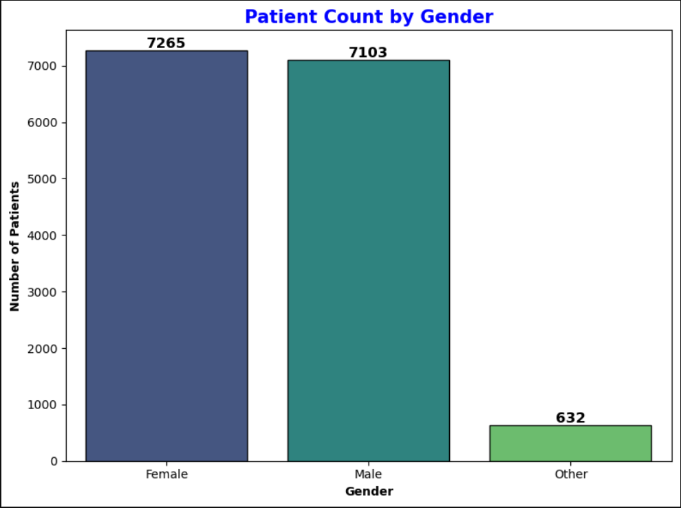
STEP 2 : DATA VISUALIZATION
Patient Count by Gender
Groups data by gender and counts patients.
→ Highlights gender representation and balance in healthcare access.

Slide 10
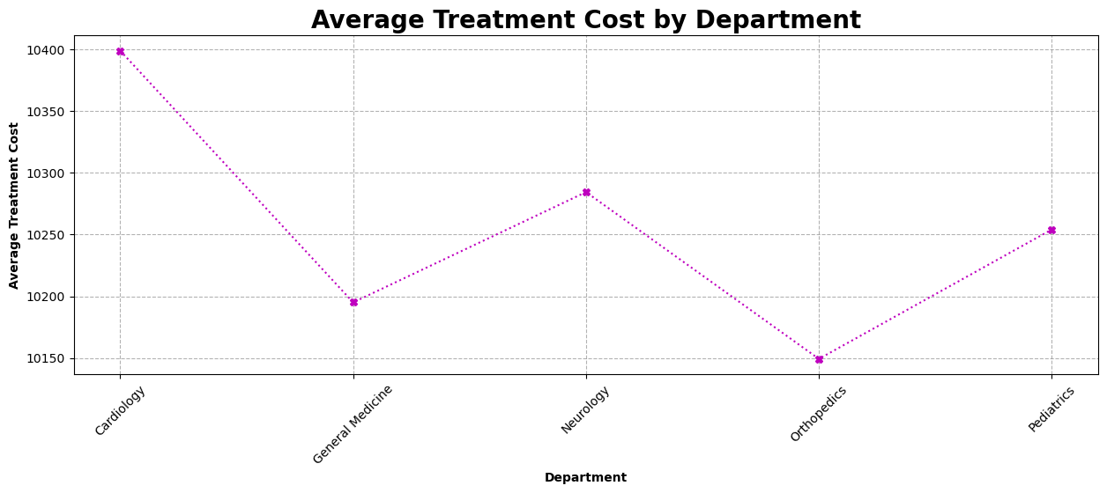
Average Treatment Cost by Department
Computes mean cost per department.→ Identifies high-spending areas for cost optimization.

Slide 11
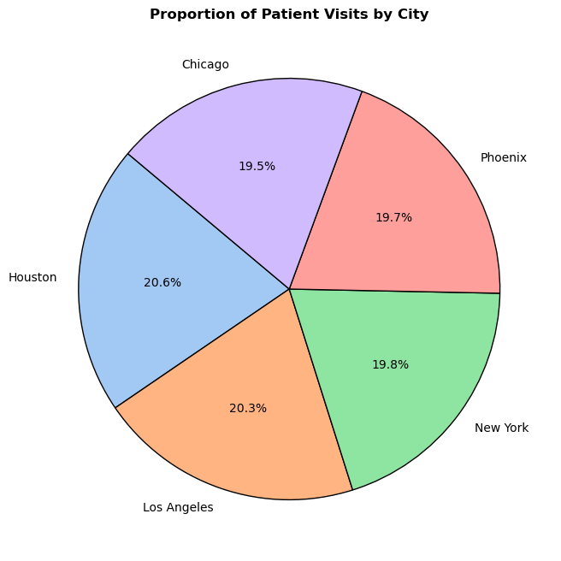
Proportion of patient visits by city
Proportion of each city .
→ Detects health issues in city treated in the hospital.

Slide 12
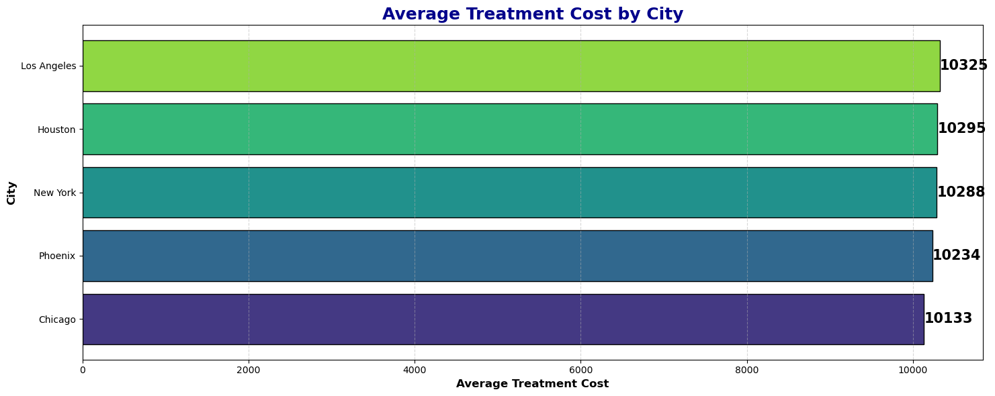
City with Highest Average Treatment Cost
Finds highest average treatment cost by city.
→ Show the los angles has highest treatment cost than other city .

Slide 13
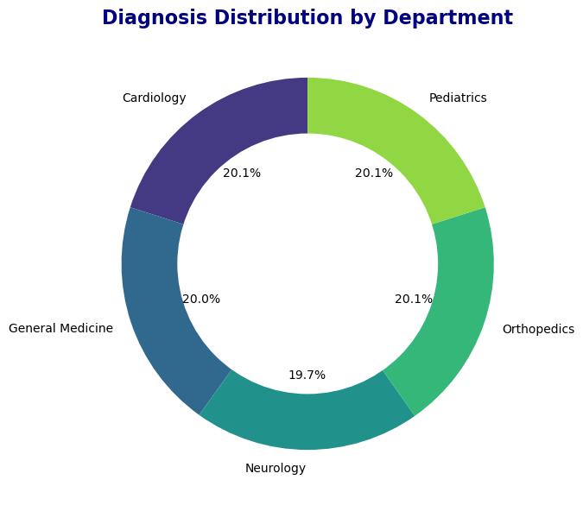
Diagnosis Distribution type by Department
Finds distribution of diagnosis by Departments.
→ Show the neurology has the lowest distribution than other department .

Slide 14
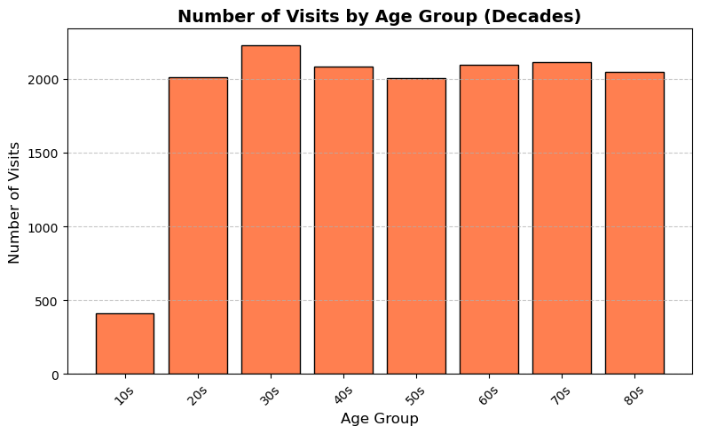
Decades with number of visits
Finds which Decades has the highest and lowest no of visitors.
→ Shows 10s (patients age who lesser than 20) related patients are the lowest

Slide 15
Key Takeaways:
Cardiology recorded the highest number of patients and treatment costs.
Age group 30–39 years had the most frequent visits.
Female patients showed slightly higher satisfaction scores.
30% of patients returned for follow-up visits.
A positive correlation between age and treatment cost suggests older patients generally incur higher expenses.

Slide 16
Conclusion
This project successfully demonstrates how Python and SQL can be integrated to perform effective healthcare data analysis.
By examining patient demographics, treatment costs, satisfaction levels, and follow-up patterns, valuable insights were discovered that can guide hospital management decisions.

Slide 17
Thank you

